Slide 1
Rockbuster Stealth 2020 Analysis
Jia Sing Guan

Slide 2
Agenda
Introduction
Objective
Top 10 movies that contributed the most to revenue
Top 10 movies that contributed the least to revenue
Top 10 countries by number of customers
Countries with the highest customer lifetime value
Revenue breakdown by genre
Revenue breakdown by movie rating
Recommendations & other insights

Slide 3
Introduction
Rockbuster Stealth LLC is a movie rental company that used to have stores around the world. Facing stiff competition from streaming services such as Netflix and Amazon Prime, the Rockbuster Stealth management team is planning to use its existing movie licenses to launch an online video rental service in order to stay competitive.

Slide 4
Objective
The Rockbuster Stealth Management Board has asked a series of business questions and they expect data-driven answers that they can use for their 2020 company strategy. Here are the main questions they’d like to answer:
Which movies contributed the most/least to revenue gain?
What was the average rental duration for all videos?
Which countries are Rockbuster customers based in?
Where are customers with a high lifetime value based?
What is the revenue breakdown of all movie ratings?

Slide 5
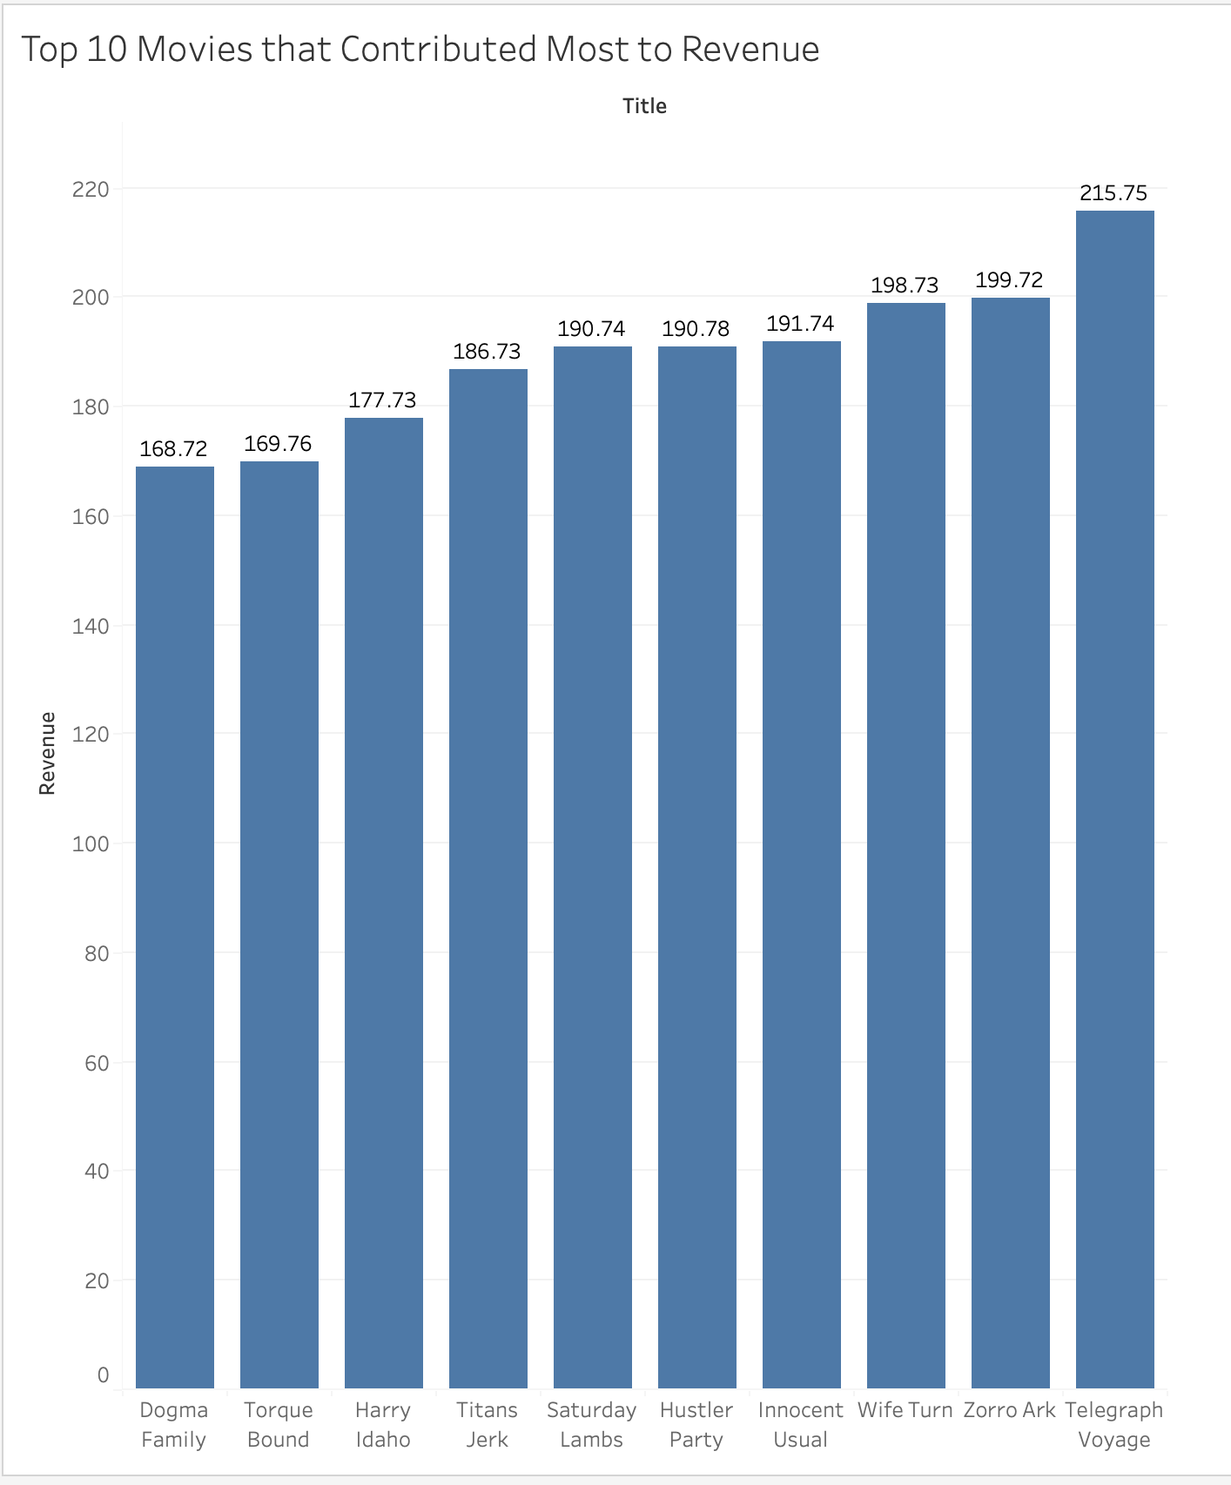
Top 10 movies that contributed the most to revenue
The top 10 movies that contributed the most to revenue are: Telegraph Voyage, Zorro Ark, Wife Turn, Innocent Usual, Hustler Party, Saturday Lambs, Titans Jerk, Harry Idaho, Torque Bound, and lastly, Dogma Family.
We recommend capitalizing on the success of the top movies by continuing to promote them and create additional revenue streams based on them.

Slide 6
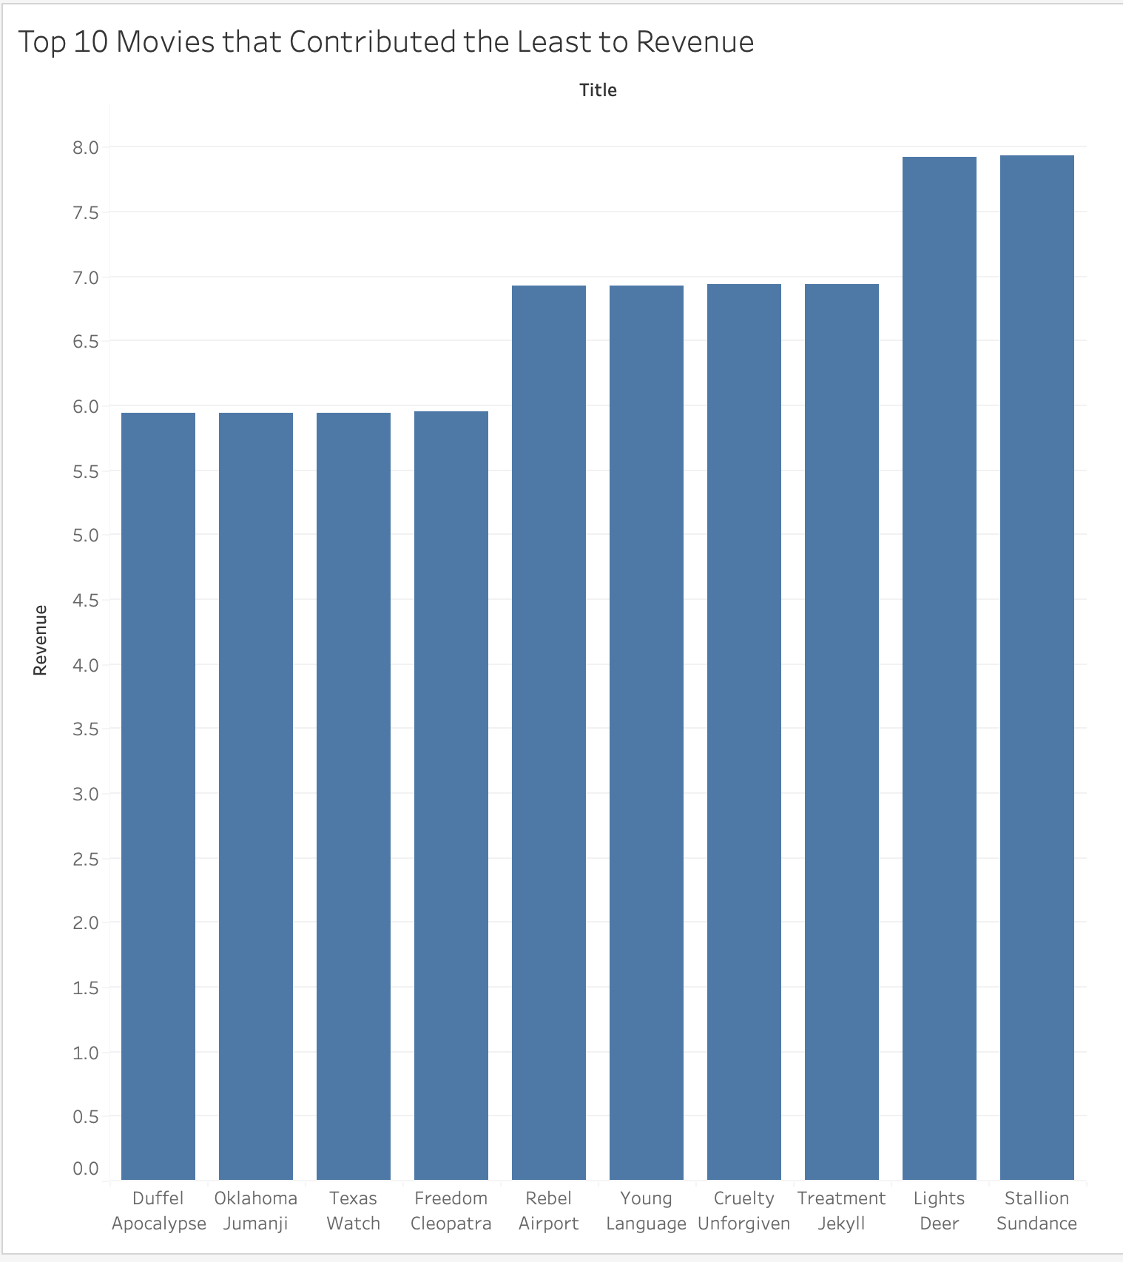
Top 10 movies that contributed the least to revenue
The top 10 movies that contributed the least to revenue are: Stallion Sundance, Lights Deer, Treatment Jekyll, Cruelty Unforgiven, Young Language, Rebel Airport, Freedom Cleopatra, Texas Watch, Oklahoma Jumanji, and lastly, Duffel Apocalypse.
We recommend dropping the movie licenses for these movies and utilize the resources for movies that generate higher revenue.

Slide 7
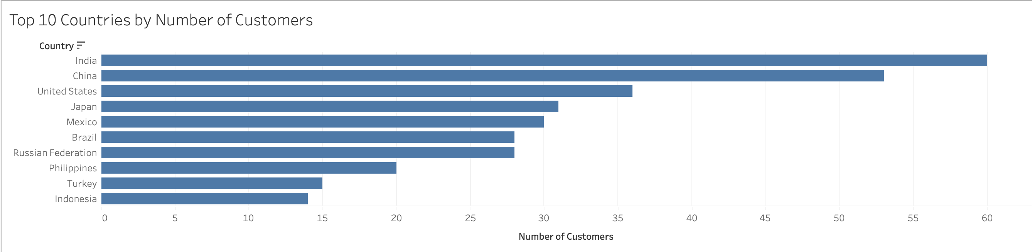
Top 10 countries by number of customers
The top 10 countries by the number of customers are: India, China, United States, Japan, Mexico, Brazil, Russian Federation, Philippines, Turkey, and lastly, Indonesia

Slide 8
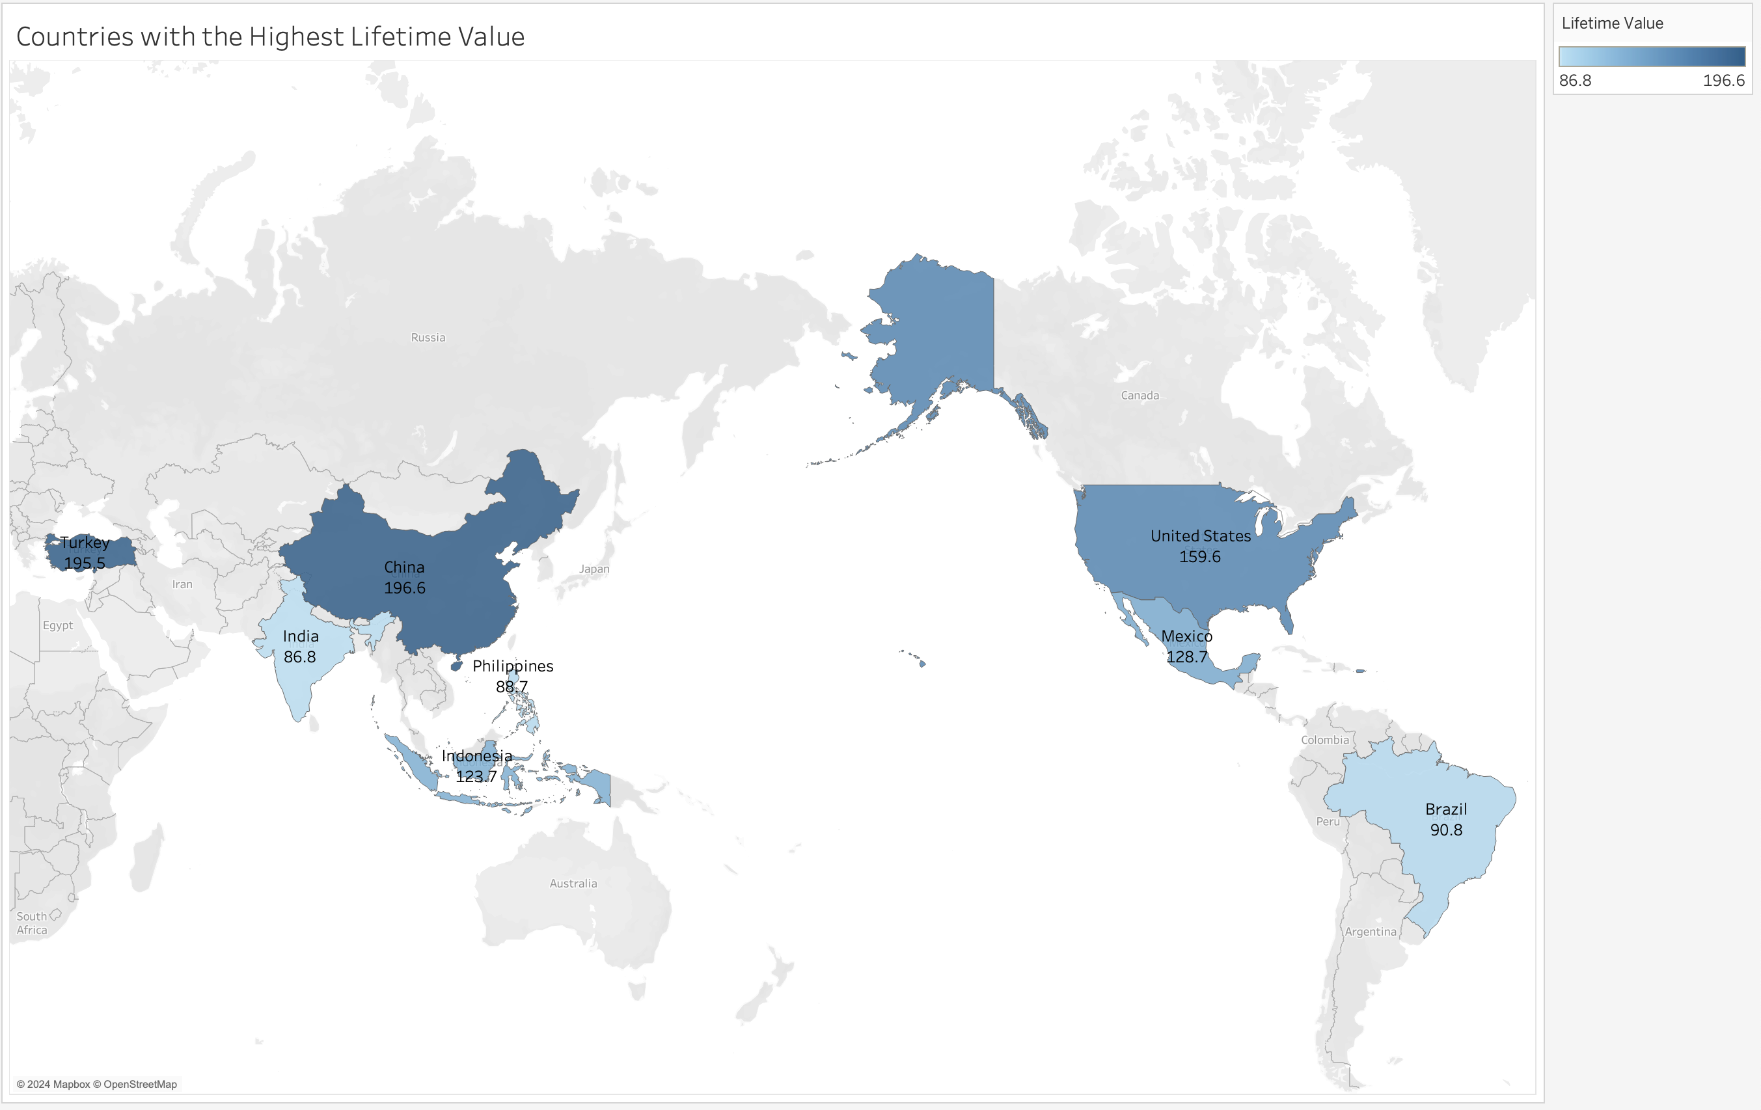
Countries with the highest customer lifetime value
The countries with the highest customer lifetime value are: China, Turkey, United States, Mexico, Indonesia, Brazil, Philippines, and lastly, India.
We recommend promoting the online rental service in these countries first to capitalize on the high customer lifetime value.

Slide 9
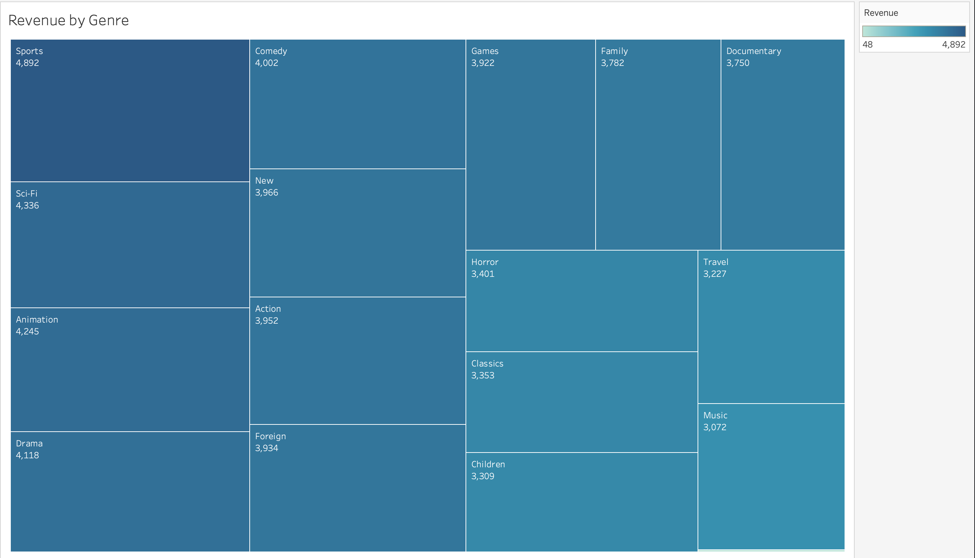
Revenue breakdown by genre
The top 10 genres that produce the most revenue are: Sports, Sci-Fi, Animation, Drama, Comedy, New, Action, Foreign, Games, and lastly, Horror.
We recommend promoting movies from the top genres to maximize viewership and revenue.

Slide 10
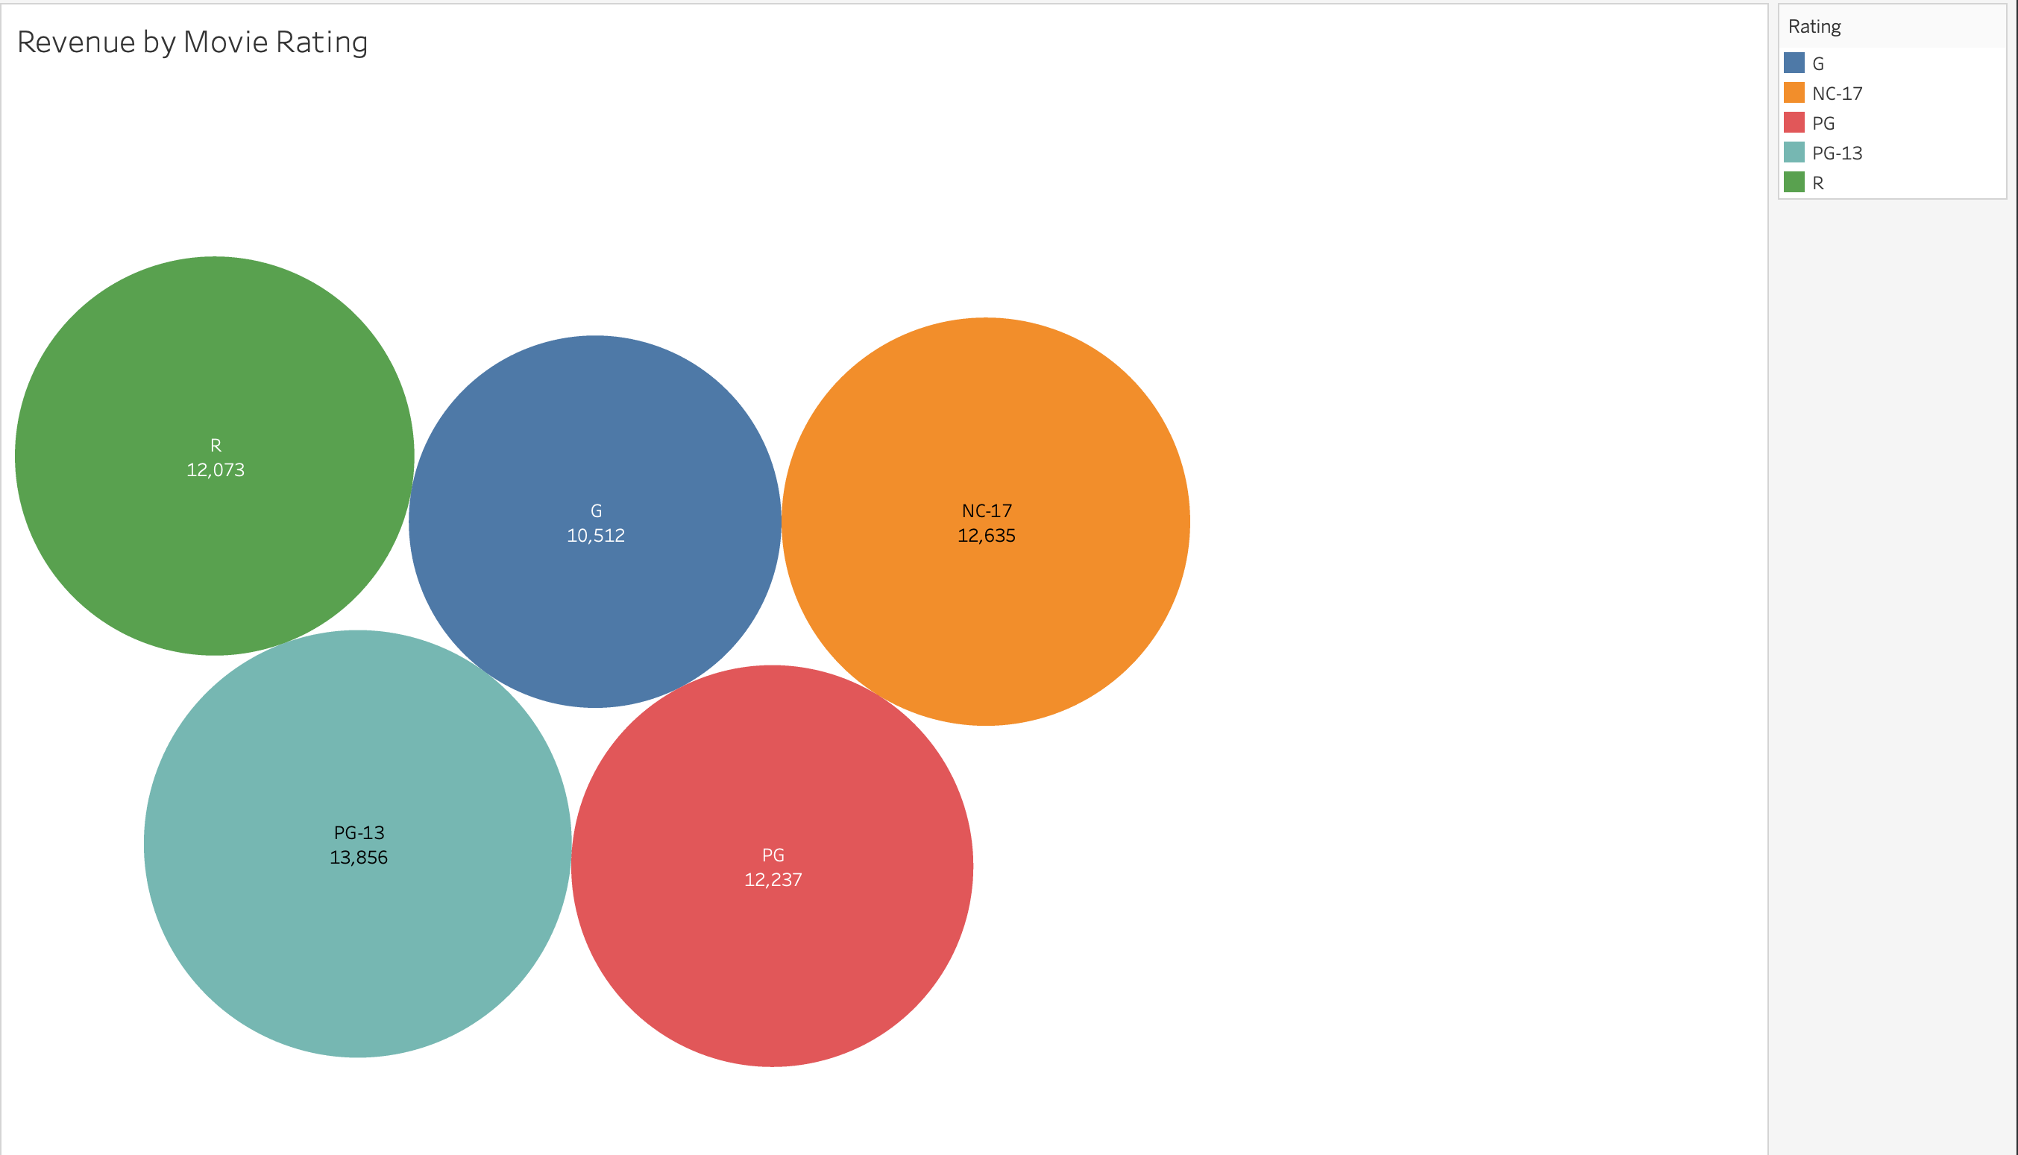
Revenue breakdown by movie rating
Movies rated PG-13 had the greatest revenue, followed by NC-17, and then PG, R, and lastly, G.
We recommend promoting movies with the PG-13 rating first, followed by NC-17, and then PG, R, and lastly, G to maximize viewership and revenue

Slide 11
Recommendations & other insights
Other insight: The average rental duration is 5 days.
After analyzing the data, we recommend Rockbuster Stealth to promote the top movies that contributed the most to revenue and to drop the movie licenses for ones that contributed the least.
We also recommend focus promotion activities on countries with the highest number of customers (India, China, United States) and highest customer lifetime value (China, Turkey, United States).
Lastly, we recommend focusing on movies that are rated PG-13 and in the Sports category to maximize revenue.

